Slide 1
Compiler Construction
Lecture 9
Type Checking

Slide 2
Type Checking (Chapter 6)

Slide 3
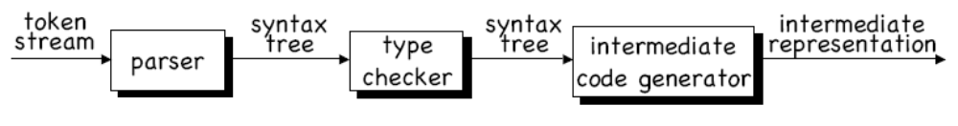
Type Checking
TYPE CHECKING is the main activity in semantic analysis.
Goal: calculate and ensure consistency of the type of every expression in a program
If there are type errors, we need to notify the user.
Otherwise, we need the type information to generate code that is correct.

Slide 4
Type Systems and Type Expressions

Slide 5
Type systems
Every language has a set of types and rules for assigning types to language constructs.
Example from the C specification:
  “The result of the unary & operator is a pointer to the object referred to by the operand. If the type of the operand is ‘…’ then the type of the result is ‘pointer to …’
Usually, every expression has a type.
Type have structure: the type ‘pointer to int’ is
CONSTRUCTED from the type ‘int’

Slide 6
Basic vs. constructed types
Most programming languages have basic and constructed types.
BASIC TYPES are the atomic types provided by the language.
  Pascal: boolean, character, integer, real
  C: char, int, float, double
CONSTRUCTED TYPES are built up from basic types.
  Pascal: arrays, records, sets, pointers
  C: arrays, structs, pointers

Slide 7
Type expressions
We denote the type of language constructs with TYPE
EXPRESSIONS.
Type expressions are built up with TYPE CONSTRUCTORS.
A basic type is a type expression. The basic types are boolean, char, integer, and real. The special basic type type_error signifies an error. The special type void signifies “no type”
A type name is a type expression (type names are like typedefs in C)

Slide 8
Type expressions
A type constructor applied to type expressions is a type expression.
  Arrays: if T is a type expression, then pointer(T) is a type expression denoting the type “pointer to an object of type T”
    Array(I,T) ⬅ I: index set, T: element type
  Products: if T1 and T2 are type expressions, then their Cartesian product T1 × T2 is also a type expression.
  Records: a record is a special kind of product in which the fields have names (examples below)
  Pointers: if T is a type expression, then pointer(T) is a type expression denoting the type “pointer to an object of type T”
  Functions: functions map elements of a domain D to a range R, so we write D -> R to denote “function mapping objects of type D to objects of type R” (examples below)
Type expressions may contain variables, whose values are themselves type expressions. ⬅ polymorphism

Slide 9
Record type expressions
The Pascal code
type row = record
address: integer;
lexeme: array[1..15] of char
end;
var table: array[1..10] of row;
associates type expression
record((address × integer) × (lexeme × array(1..15,char)))
with the variable row, and the type expression
array(1..101,record((address × integer) × (lexeme × array(1..15,char)))
with the variable table

Slide 10
Function type expressions
The C declaration
int *foo( char a, char b );
would associate type expression
char × char -> pointer(integer)
with foo. Some languages (like ML) allow all sorts of crazy function types, e.g.
(integer -> integer) -> (integer -> integer)
denotes functions taking a function as input and returning another function

Slide 11
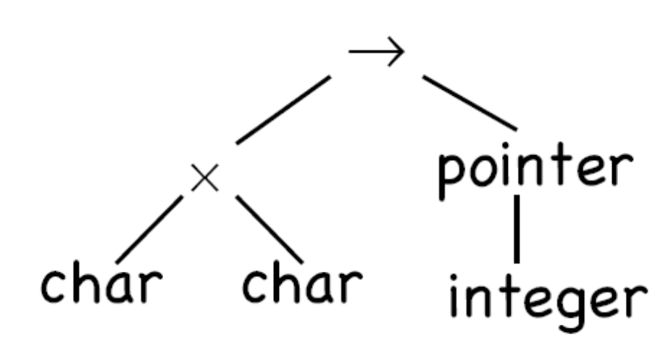
Graph representation of type expressions
The recursive structure of a type can be represented with a tree, e.g. for char × char -> pointer(integer):
Some compilers explicitly use graphs like these to represent the types of expressions.

Slide 12
Type systems and checkers
A TYPE SYSTEM is a set of rules for assigning type expressions to the parts of a program.
Every type checker implements some type system.
Syntax-directed type checking is a simple method to implement a type checker.

Slide 13
Static vs. dynamic type checking
STATIC type checking is done at compile time.
DYNAMIC type checking is done at run time.
Any kind of type checking CAN be done at run time.
But this reduces run-time efficiency, so we want to do static checking when possible.
A SOUND type system is one in which ALL type errors can be found statically.
If the compiler guarantees that every program it accepts will run without type errors, then the language is STRONGLY TYPED.

Slide 14
An Example Type Checker

Slide 15
Example type checker
Let’s build a translation scheme to synthesize the type of every expression from its subexpressions.
Here is a Pascal-like grammar for a sequence of declarations (D) followed by an expression (E)
Example program: key: integer;
key mod 1999
P → D ; E
D → D ; D | id : T
T → char | integer | array [ num ] of T | ↑ T
E → literal | num | id | E mod E | E [ E ] | E ↑

Slide 16
The type system
The basic types are char and integer.
type_error signals an error.
All arrays start at 1, so
array[256] of char
leads to type expression: array(1..256,char)
The symbol ↑ in an declaration specifies a pointer type,
so
↑ integer
leads to type expression: pointer(integer)

Slide 17
Translation scheme for declarations
P → D ; E
D → D ; D
D → id : T { addtype(id.entry, T.type) }
T → char { T.type := char }
T → integer { T.type := integer }
T → ↑T₁ { T.type := pointer(T₁.type) }
T → array [ num ] of T₁
{ T.type := array(1 .. num.val, T₁.type) }
Try to derive the annotated parse tree for the
declaration X: array[100] of ↑ char

Slide 18
Type checking for expressions
Once the identifiers and their types have been inserted into the symbol table, we can check the type of the elements of an expression:
E → literal { E.type := char }
E → num { E.type := integer }
E → id { E.type := lookup(id.entry) }
E → E₁ mod E₂ { if E₁.type =integer and E₂.type = integer
then E.type := integer
else E.type := type_error }
E → E₁ [ E₂ ] { if E₂.type = integer and E₁.type = array(s,t)
then E.type := t else E.type := type_error }
E → E₁↑ { if E₁.type = pointer(t)
then E.type := t else E.type := type-error }

Slide 19
How about boolean types?
Try adding
T -> boolean
Relational operators < <= = >= > <>
Logical connectives and or not
to the grammar, then add appropriate type checking semantic actions.

Slide 20
Type checking for statements
Usually we assign the type VOID to statements.
If a type error is found during type checking, though, we should set the type to type_error
Let’s change our grammar allow statements:
P → D ; S
i.e., a program is a sequence of declarations followed by a sequence of statements.

Slide 21
Type checking for statements
Now we need to add productions and semantic actions:
S → id := E { if id.type = E.type then S.type := void
else S.type := type_error }
S → if E then S₁ { if E.type = boolean
then S.type := S₁.type
else S.type := type_error }
S → while E do S₁ { if E.type = boolean
then S.type := S₁.type
else S.type := type_error }
S → S₁ ; S₂ { if S₁.type = void and S₂.type = void
then S.type := void
else S.type := type_error.

Slide 22
Type checking for function calls
Suppose we add a production E → E ( E )
Then we need productions for function declarations:
T → T1 → T2 { T.type := T1.type → T2.type }
and function calls:
E → E1 ( E2 ) { if E2.type = s and E1.type = s → t
then E.type := t
else E.type := type_error }

Slide 23
Type checking for function calls
Multiple-argument functions, however, can be modeled as functions that take a single PRODUCT argument.
root : ( real → real ) x real → real
this would model a function that takes a real function
over the reals, and a real, and returns a real. In C:
float root( float (*f)(float), float x );

Slide 24
Type expression equivalence
Type checkers need to ask questions like:
– “if E1.type == E2.type, then …”
What does it mean for two type expressions to be equal?
STRUCTURAL EQUIVALENCE says two types are the same if they are made up of the same basic types and constructors.
NAME EQUIVALENCE says two types are the same if their constituents have the SAME NAMES.

Slide 25
Structural Equivalence
boolean sequiv( s, t )
{
if s and t are the same basic type
return TRUE;
else if s == array( s₁, s₂ ) and t == array( t₁, t₂ )
return sequiv( s₁, t₁ ) and sequiv( s₂, t₂ )
else s == s₁ x s₂ and t = t₁ x t₂ then
return sequiv( s₁, t₁ ) and sequiv( s₂, t₂ )
else if s == pointer( s₁ ) and t == pointer( t₁ )
return sequiv( s₁, t₁ )
else if s == s₁ → s₂ and t == t₁ → t₂ then
return sequiv( s₁, t₁ ) and sequiv( s₂, t₂ )
return false
}
Try: int foo( int, float )

Slide 26
Relaxing structural equivalence
We don’t always want strict structural equivalence.
E.g. for arrays, we want to write functions that accept arrays of any length.
To accomplish this, we would modify sequiv() to accept any bounds:
…
else if s == array( s₁, s₂ ) and t == array( t₁, t₂ )
return sequiv( s₂, t₂ )
…

Slide 27
Encoding types
Recursive routines are very slow.
Recursive type checking routines increase the compiler’s run time.
In the compilers of the 1970’s and 1980’s, compilers took too long time to run.
So designers came up with ENCODINGS for types that allowed for faster type checking.
See Example 6.1 in the text.

Slide 28
Name equivalence
Most languages allow association of names with type expressions. This makes type equivalence trickier.
Example from Pascal:
type link = ↑cell;
var next: link;
last: link;
p: ↑ cell;
q,r: ↑ cell;
Do next, last, p, q, and r have the same type?
In Pascal, it depends on the implementation!
In structural equivalence, the types would be the same.
But NAME EQUIVALENCE requires identical NAMES.

Slide 29
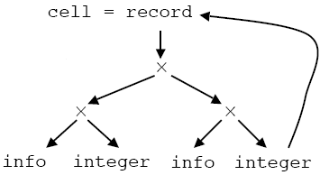
Handling cyclic types
Suppose we had the Pascal declaration
type link = ↑cell;
cell = record
info: integer;
next: link;
end;
The declaration of cell contains itself (via the next pointer).
The graph for this type therefore contains a cycle.

Slide 30
Cyclic types
The situation in C is slightly different, since it is impossible to refer to an undeclared name.
typedef struct _cell {
int info;
struct _cell *next;
} cell;
typedef *cell link;
But the name link is just shorthand for
(struct _cell *).
C uses name equivalence for structs to avoid recursion
(after expanding typedef’s).
But it uses structural equivalence elsewhere.

Slide 31
Type conversion
Suppose we encounter an expression x+i where x has type float and i has type int.
CPU instructions for addition could take EITHER float OR int as operands, but not a mix.
This means the compiler must sometimes convert the
operands of arithmetic expressions to ensure that
operands are consistent with operators.
With postfix as an intermediate language for expressions,
we could express the conversion as follows:
x i inttoreal float+
where real+ is the floating point addition operation.

Slide 32
Type coercion
If type conversion is done by the compiler without the programmer requesting it, it is called IMPLICIT conversion or type COERCION.
EXPLICIT conversions are those that the programmer
specifices, e.g.
x = (int)y * 2;
Implicit conversion of CONSTANT expressions should be done at compile time.

Slide 33
Type checking example with coercion
Production Semantic Rule
E -> num E.type := integer
E -> num . num E.type := real
E -> id E.type := lookup( id.entry )
E -> E₁ op E₂ E.type := if E₁.type == integer and E₂.type == integer
then integer
else if E₁.type == integer and E₂.type == real
then real
else if E₁.type == real and E₂.type == integer
then real
else if E₁.type == real and E₂.type == real
then real
else type_error

